Slide 1

MENTAL
HEALTH
In Technology Companies
2014
Sarah, Kirsten, Sylvester, and Alex

Slide 2
Prevalences and Demographics

Slide 3

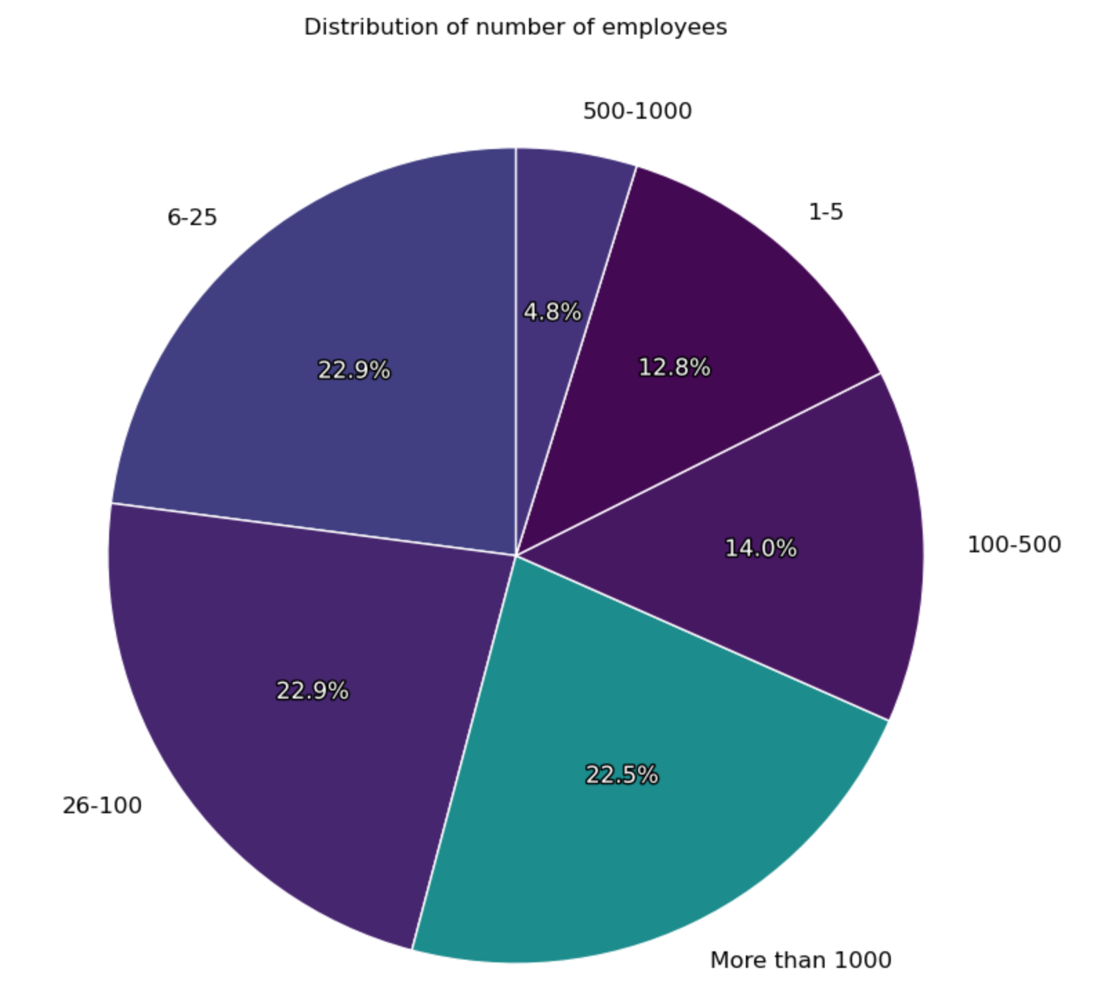
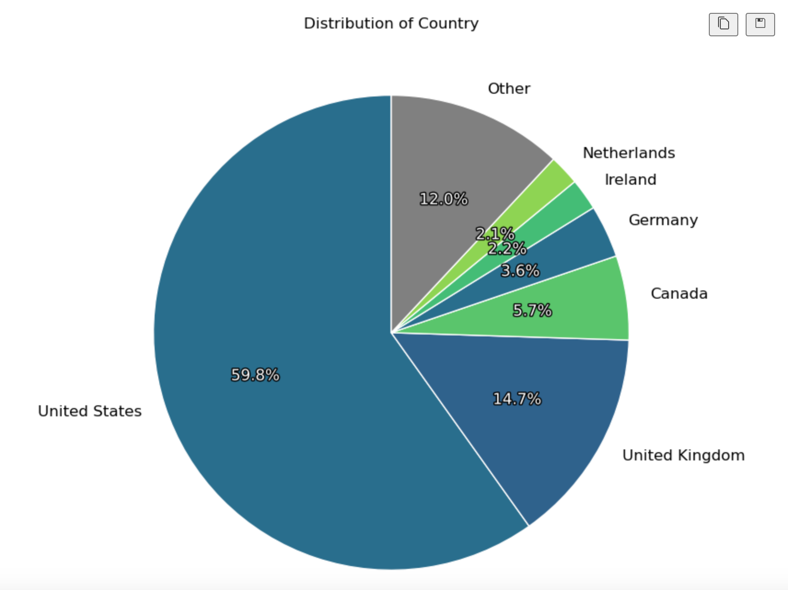
TECHNOLOGY COMPANIES: Size and Location
Majority United States based tech companies in addition to other top 5 countries of the survey who happen to be leading countries with technological expertise
Insight into other countries work culture
Consider size of companies to gain background knowledge of respondents.
Size will reflect an employee’s experiences in their work environments.

Slide 4
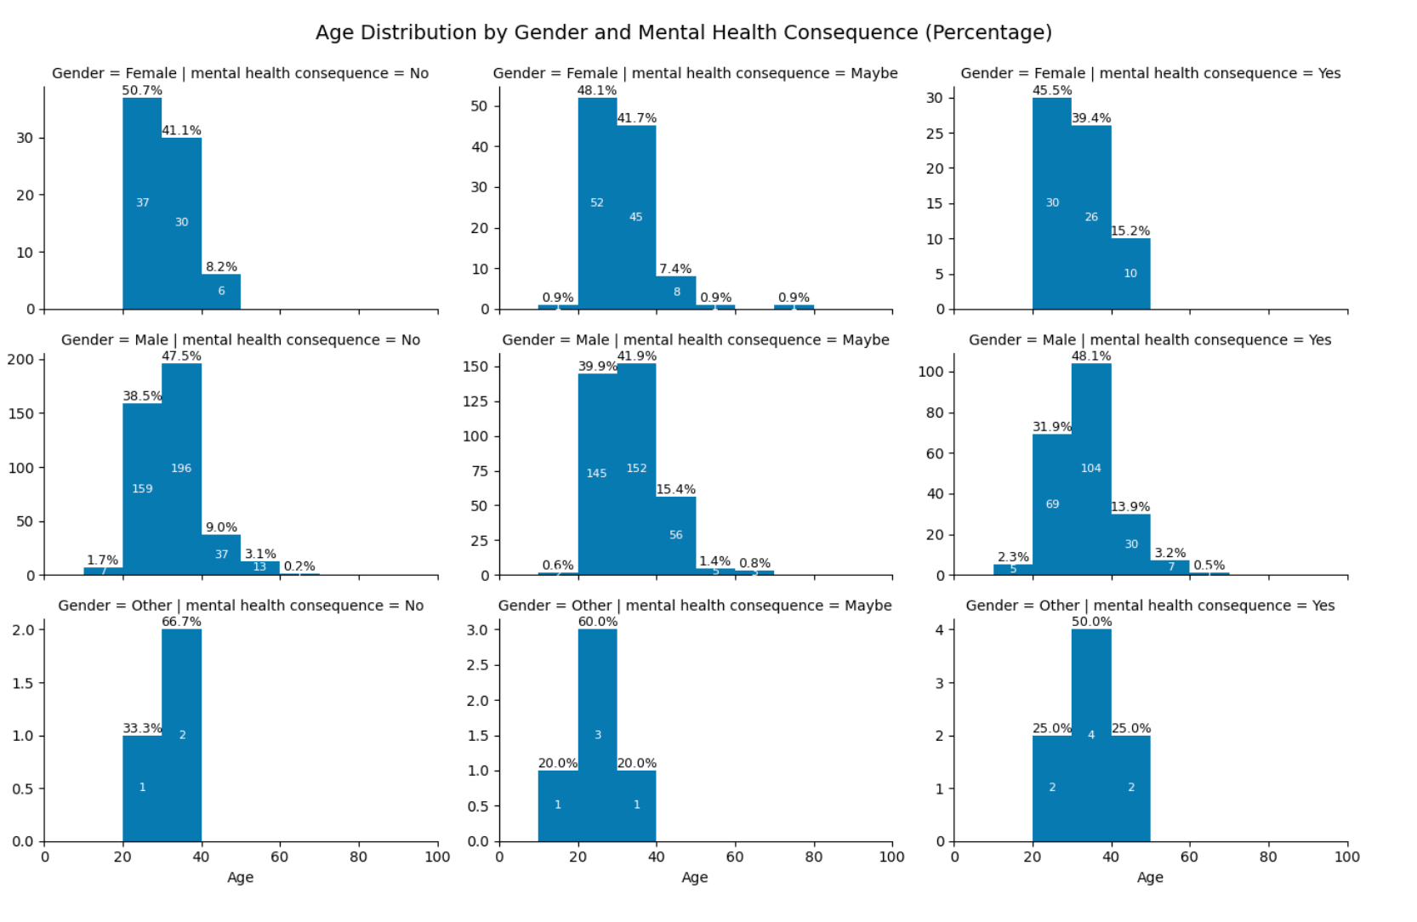
Age of Survey Respondents
Majority of age group 20 to 40 years olds
Minimum age 18
Mean age of 32
Differences in generations awareness

Slide 5

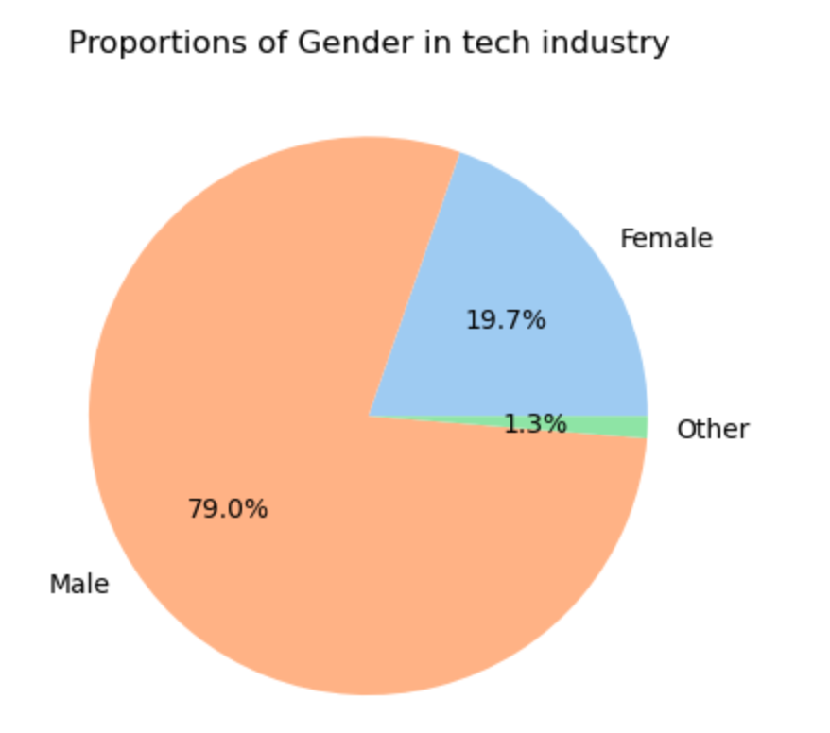
Gender Distribution
Gender inclusivity with the gender reduction to male, female and other.
Pie chart shows the proportions of the different gender identities within the technology industry and gives an understanding of gender representation in the dataset or the lack thereof.
Male majority within respondents

Slide 6
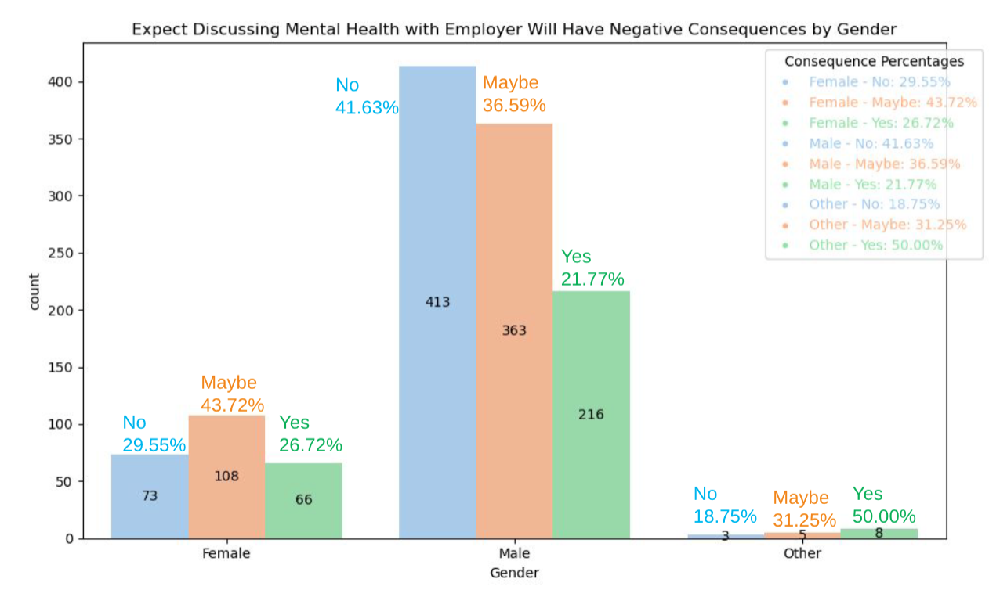
Expect Discussing Mental Health will have Negative Consequences by Gender
Plot focus on how individuals believe mental health will affects the workplace if mention in the industry.
It appears that females fear a possible consequences if they were to speak freely about mental health with 44% maybe. Unlike their male counterparts who strongly believe that there will be no effect if the mental health discussion is brought up.

Slide 7
Work Related Factors

Slide 8
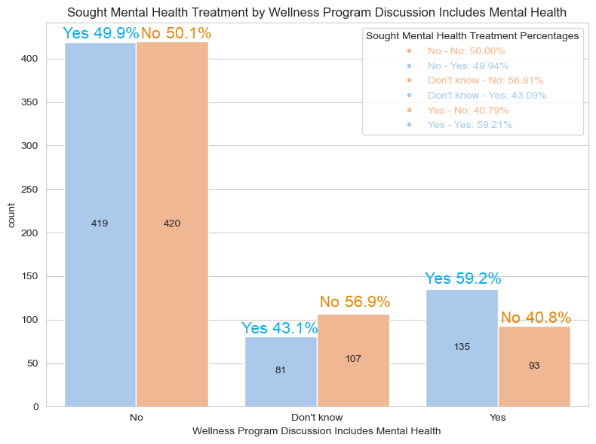
Wellness Program Effectiveness
Treatment Distribution
Visualized as count plots for each wellness program.
High treatment rates suggest program effectiveness.
Low rates highlight barriers or lack of engagement.
Treatment Percentages
High percentages: Effective in addressing mental health needs.
Low percentages: Indicate gaps in accessibility or relevance.
Statistical Insights
Chi-squared tests determine if differences are significant.
Results inform decisions to refine or scale programs.
Data Limitations
Participation Bias: Non-participants excluded.
Self-Reporting Bias: Potential inaccuracies.
External Influences: Quality, awareness, and workplace culture

Slide 9
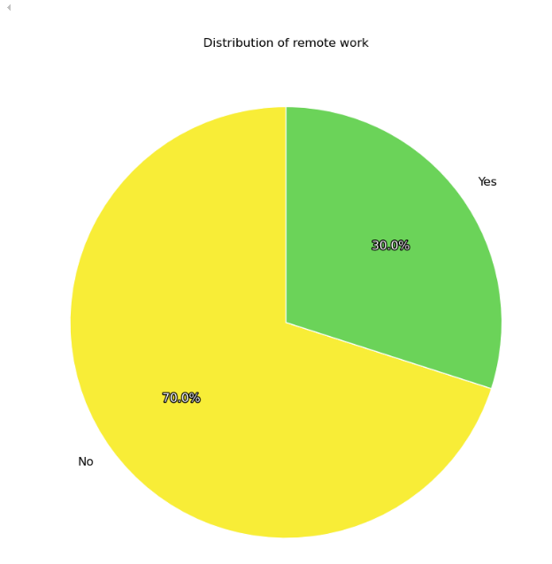
Remote Work Status
30% of employees worked remotely;
70% did not.
Potential Impact:
Flexibility of remote work can be beneficial.
Risk of isolation and burnout due to limited boundary setting.

Slide 10
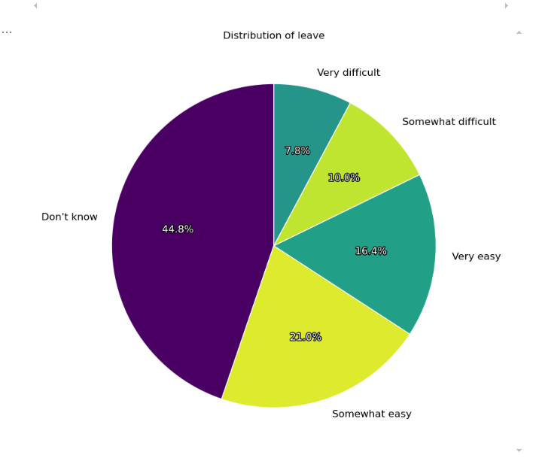
Leave Status
44.8% of employees were unsure about leave policies.
Only 16.4% found it "very easy" to take leave.
Potential Impact:
Uncertainty may discourage taking time off for recovery.
Can lead to prolonged work periods without adequate breaks.

Slide 11
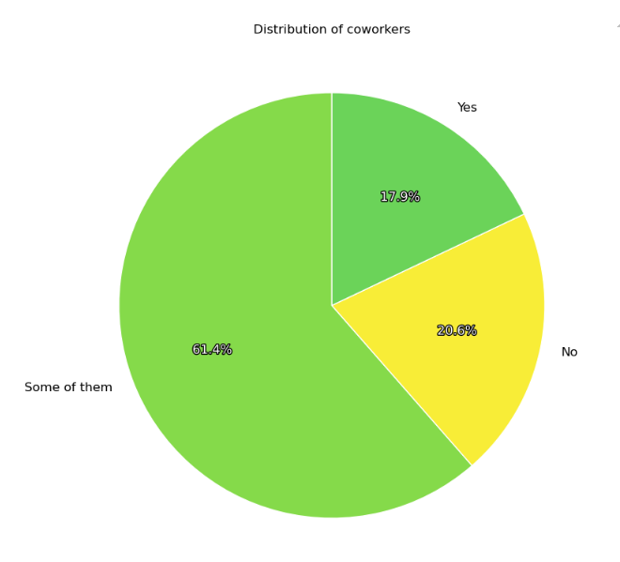
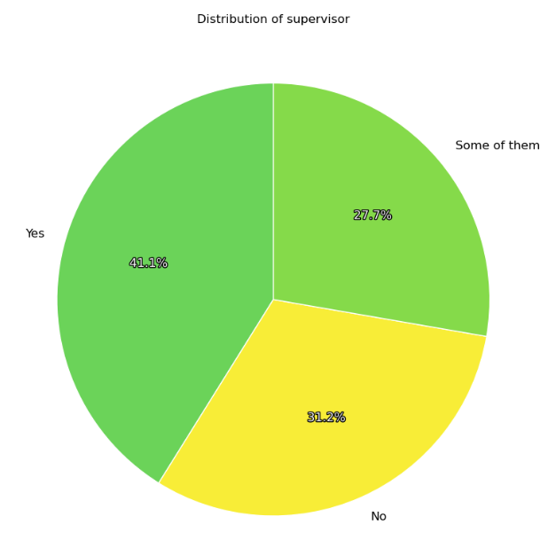
Relationships with Co-Workers & Supervisors
Co-workers:
61.4% had partial openness about mental health with coworkers.
Only 17.9% were in fully open environments.
Supervisors:
41.1% of employees felt comfortable discussing mental health openly with their supervisors

Slide 12
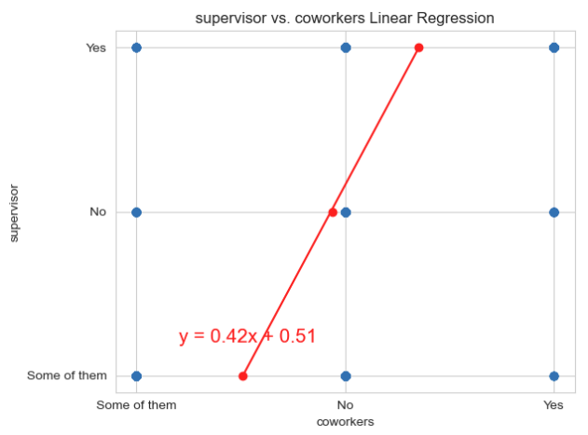
Willing to Discuss Mental Health: Co-Workers & Supervisors
R-squared = 0.33 (weak positive correlation)
Potential Impact:
Limited openness may hinder support-seeking.
Positive openness can create a more supportive environment.
Regression Line Equation:
𝑦 = 0.42𝑥 + 0.51
Slope (0.42): Positive association between coworker and supervisor awareness.
Indicates that as coworker awareness increases, supervisor awareness also tends to increase.
Intercept (0.51): Predicted moderate level
of supervisor awareness when coworker
awareness is minimal.

Slide 13
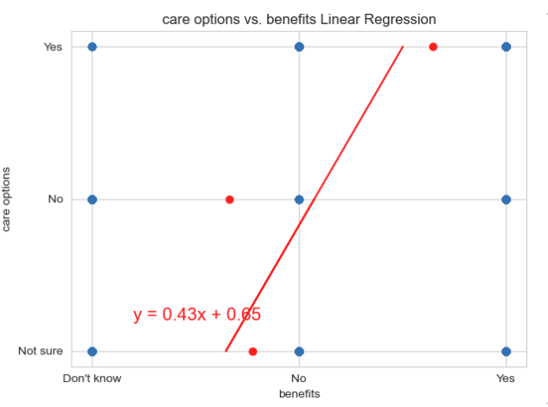
Availability of Mental Health Benefits
R-squared = 0.20 (weak positive correlation)
Key Insights:
Availability of benefits is positively associated with the likelihood of offering care options.
Employees with benefits are slightly more likely to report access to mental health care options.
Potential Impact:
Shows that benefits availability may support the provision of mental health care options.
Reinforces the value of offering comprehensive benefits that include mental health support.

Slide 14
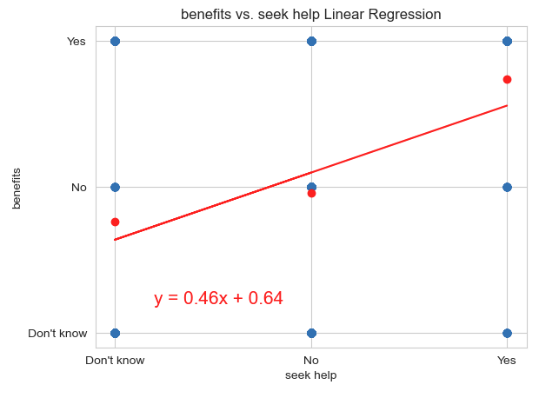
Availability of Mental Health Benefits
R-squared = 0.22 (weak positive correlation)
Key Insights:
Employees with benefits are slightly more likely to seek help for mental health concerns.
Indicates that benefits can have a positive effect on employees' willingness to seek support.
Potential Impact:
Highlights the importance of benefits in encouraging help-seeking behavior.
Shows that even a modest increase in benefits can positively influence mental health support usage.

Slide 15
Mental Health In Tech By Country

Slide 16
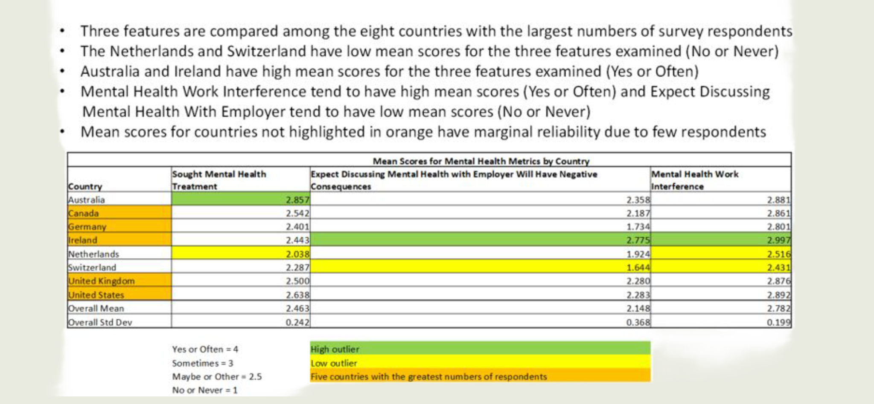
Tables of Mean Feature Scores by Country

Slide 17
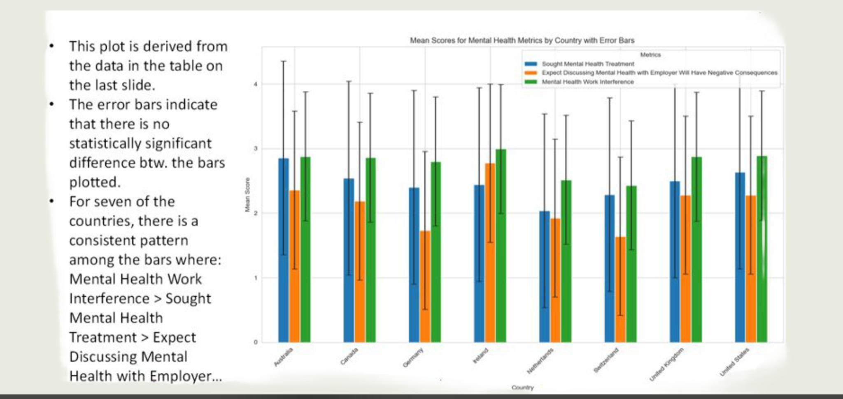
Plot of Mean Feature Scores by Country

Slide 18
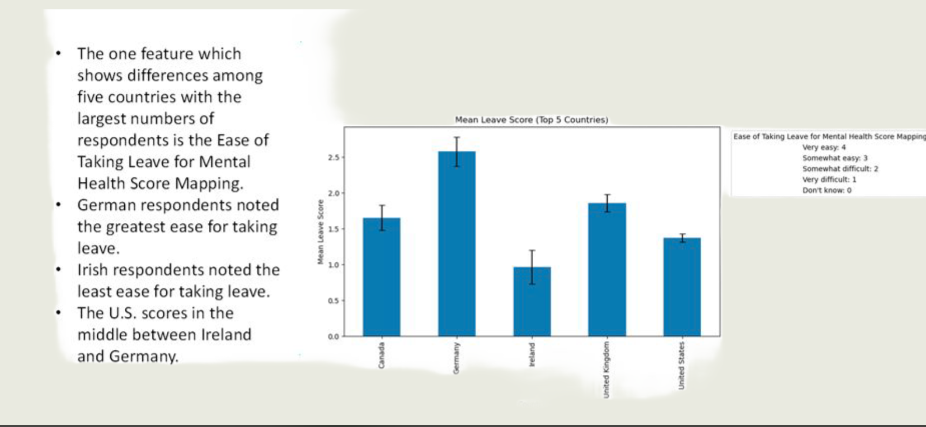
Plot of Mean Mental Health Work Interference Scores by Country

Slide 19
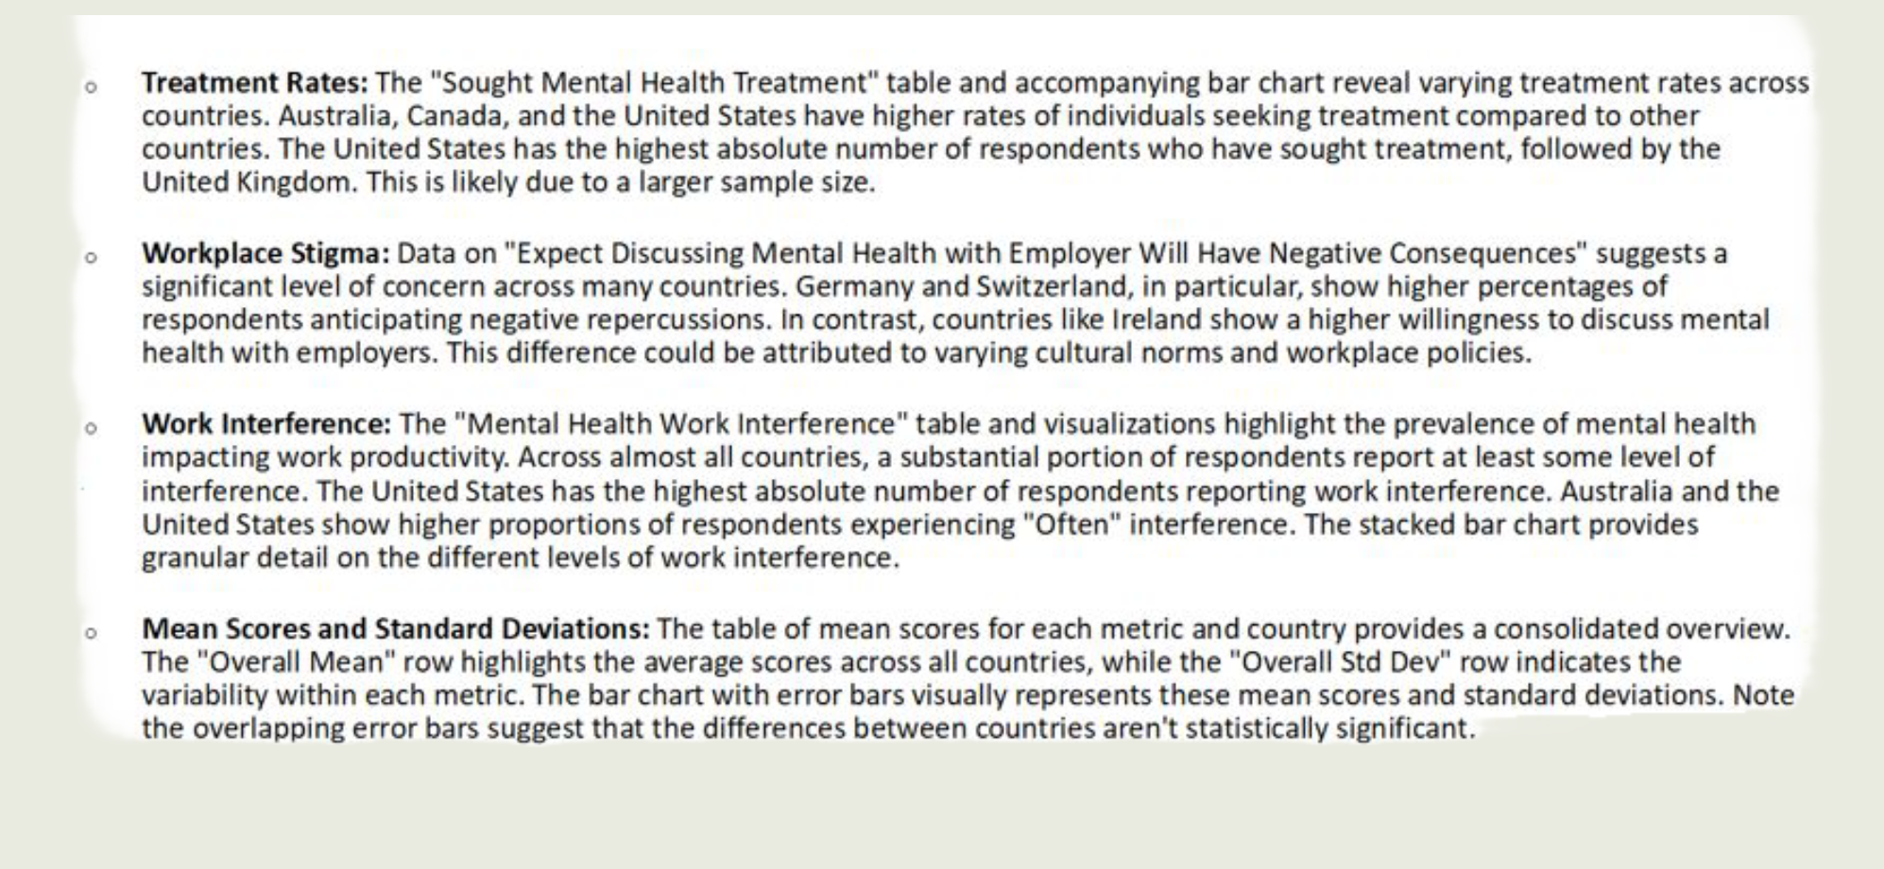
Summary: Mental Health in Tech Among Countries

